Slide 1
Cardio Health Monitor
By Mohit Mittal

Slide 2
Problem Statement
Every Year 735,000 Americans Have a Heart Attack
1 in Every 4 Deaths in USA is Due to Heart Attack
47% of Deaths Occur Outside Hospital Because People Don’t Act On Early Warning Signs

Slide 3
Solution
Cardio Health Monitor keeps a record of vital signs of the patient
Calls Ambulance if he is having a heart attack
Alerts Patient if he is at a risk of heart attack
The doctor can see the live feeds of vital signs of patient

Slide 4
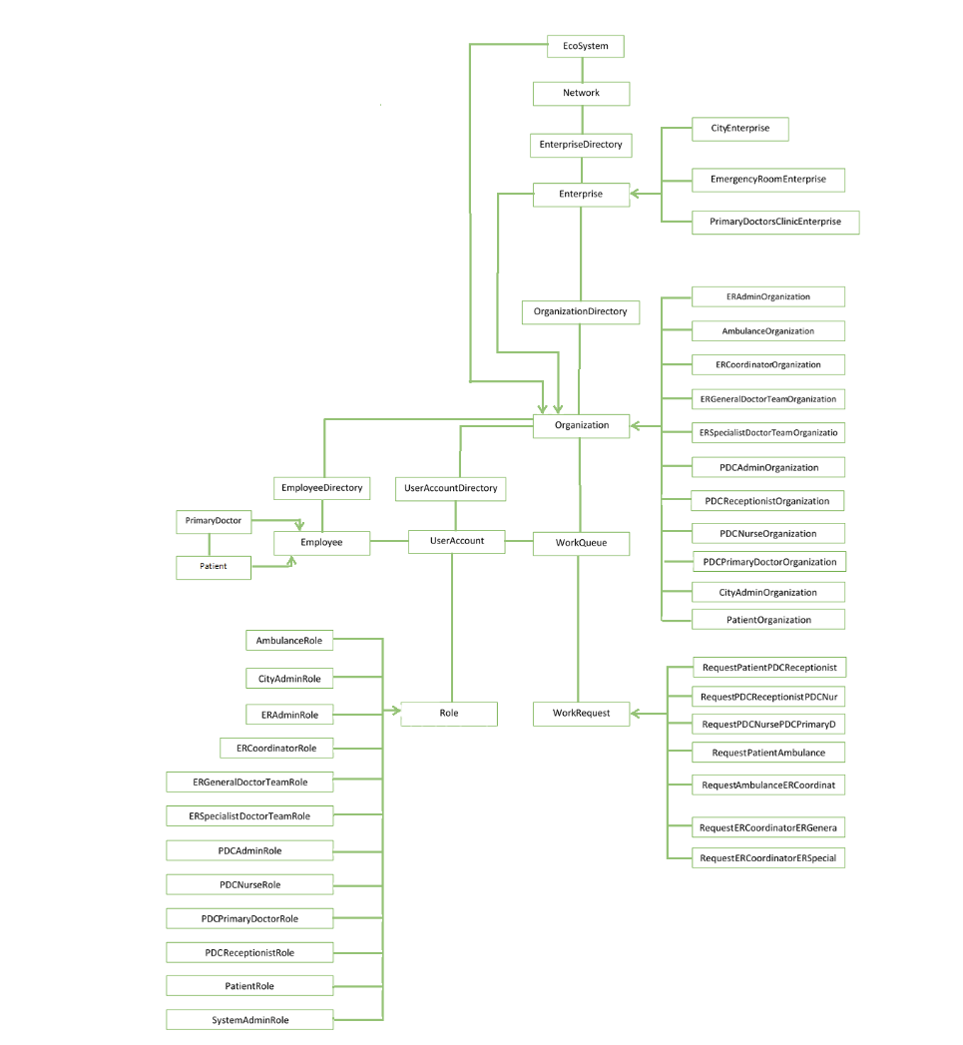
Object Model

Slide 5
Key Roles
Patient
Primary Doctor
Ambulance
Emergency Room General Team
Emergency Room Specialist Team

Slide 6
Key Features
The vital signs of patient are recorded using IoT Device
The ambulance to be called is selected on the basis of their time to reach the patient
Advanced Tests are performed in the ambulance and results are sent to the emergency room
Emergency room is selected on the basis of the time to reach plus the waiting time
The primary doctor can see the live feeds of vital signs in graphical form

Slide 7
Assumptions
The ECG is recorded in a single integer value
The Location is stored in a single integer value

